Slide 1
Session 2 – Operations
MIS 6311-501 Cyber Security Fundamentals
Chris Davis

Slide 2
Housekeeping
Any Questions? Please do not hesitate to email. Or text.
Class Website: https://elearning.utdallas.edu
Dropbox: https://goo.gl/9AFyoE
UTD Email: cmd140430@utdallas.edu
Gmail: davischr2@gmail.com
Google Voice: 214-771-8122 (Text & Emergencies)
LinkedIn: www.LinkedIn.com/in/ChristopherDavis
Blog: www.cloudauditcontrols.com
Class: Monday 7:00pm-9:45pm JSOM 12.210

Slide 3
Academic Calendar & Sessions

Slide 4
Comparison of Our Class to CISSP Domains
Shon Harris Book – Chapters
Current CISSP Domains
2
Information Security Governance and Risk Management
8
Business Continuity and Disaster Recovery Planning
Security and Risk Management
9
Legal, Regulations, Investigations and Compliance
7
Cryptography
Security Engineering
4
Security Architecture and Design
Security Assessment and Testing
5
Physical (Environmental) Security
Asset Security
6
Telecommunications and Network Security
Communications and Network Security
3
Access Control
Identity and Access Management
11
Operations Security
Security Operations
10
Software Development Security
Software Development Security

Slide 5
Tales from the Crypt.
Practical Applications & Lessons Learned.

Slide 6
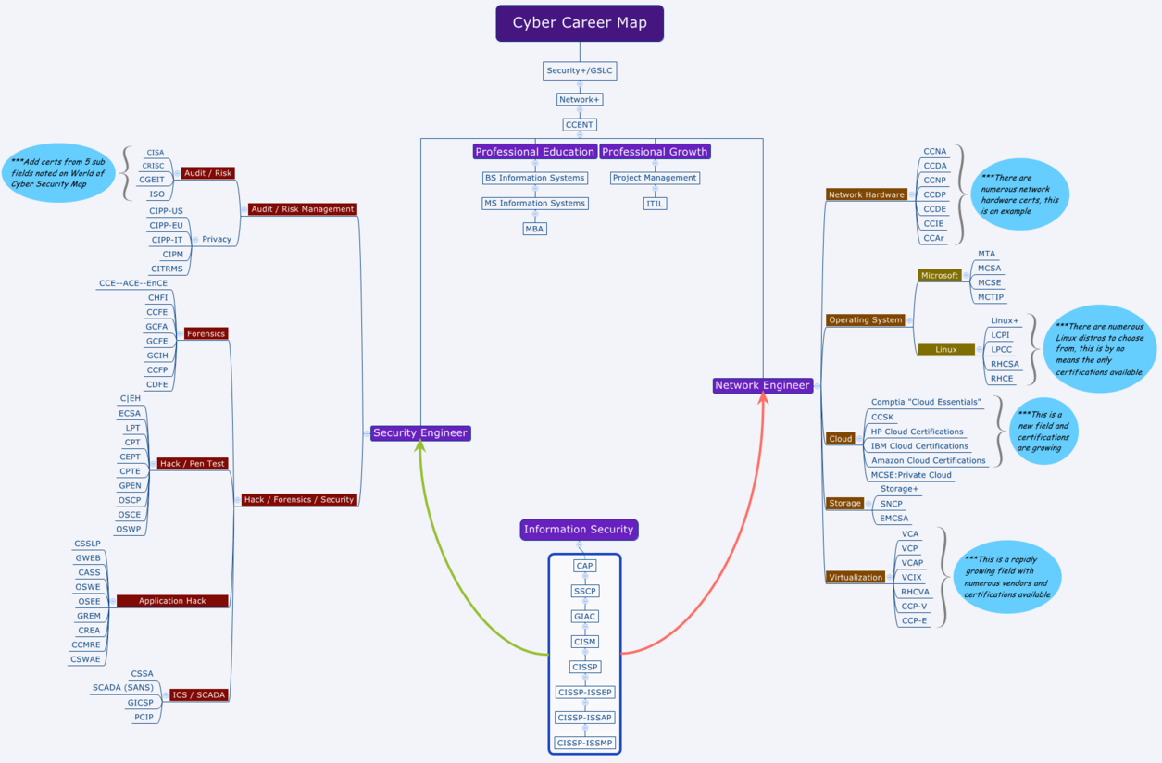
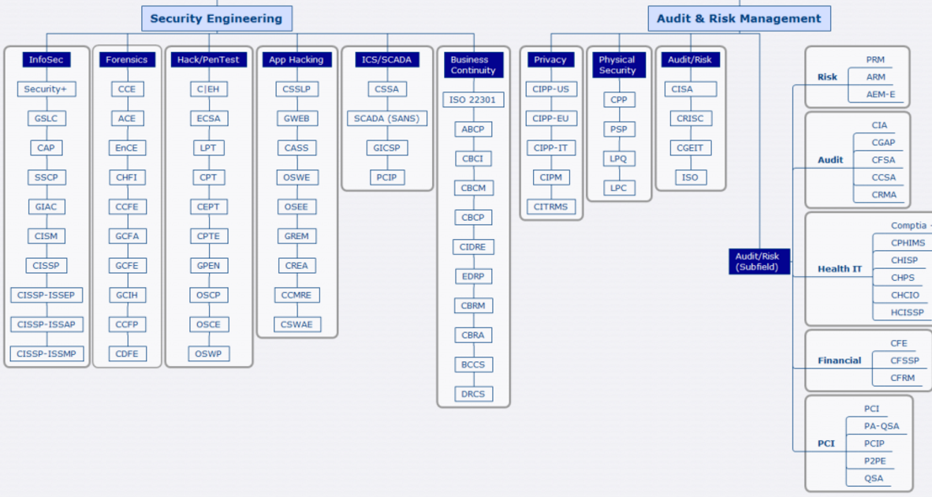
https://www.linkedin.com/in/ghayslip

Slide 7
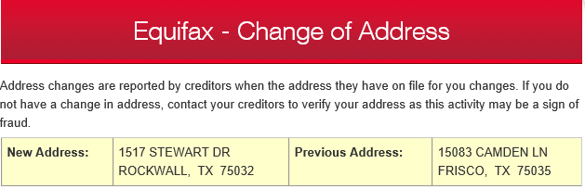

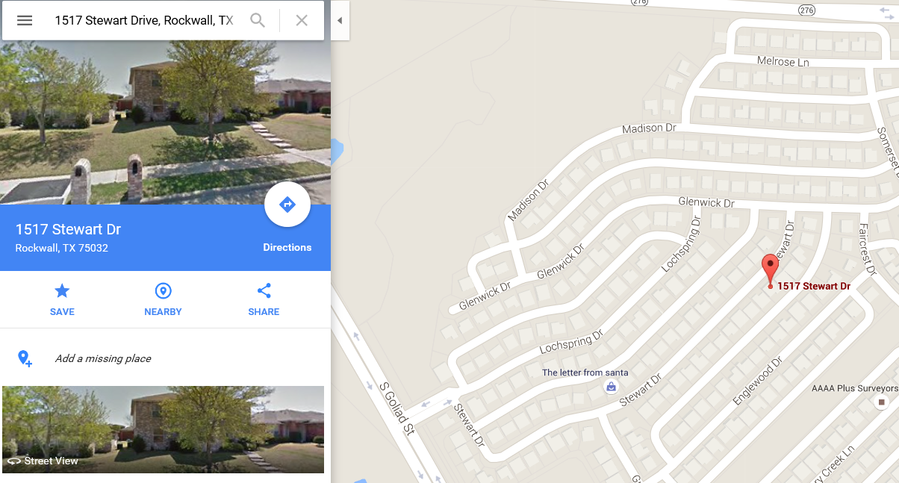

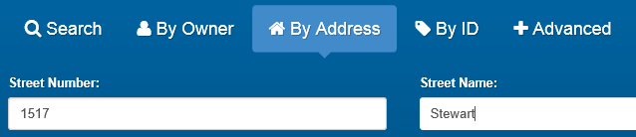
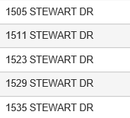
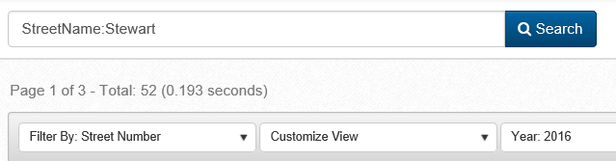
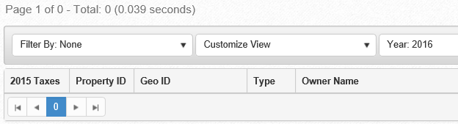

Slide 8
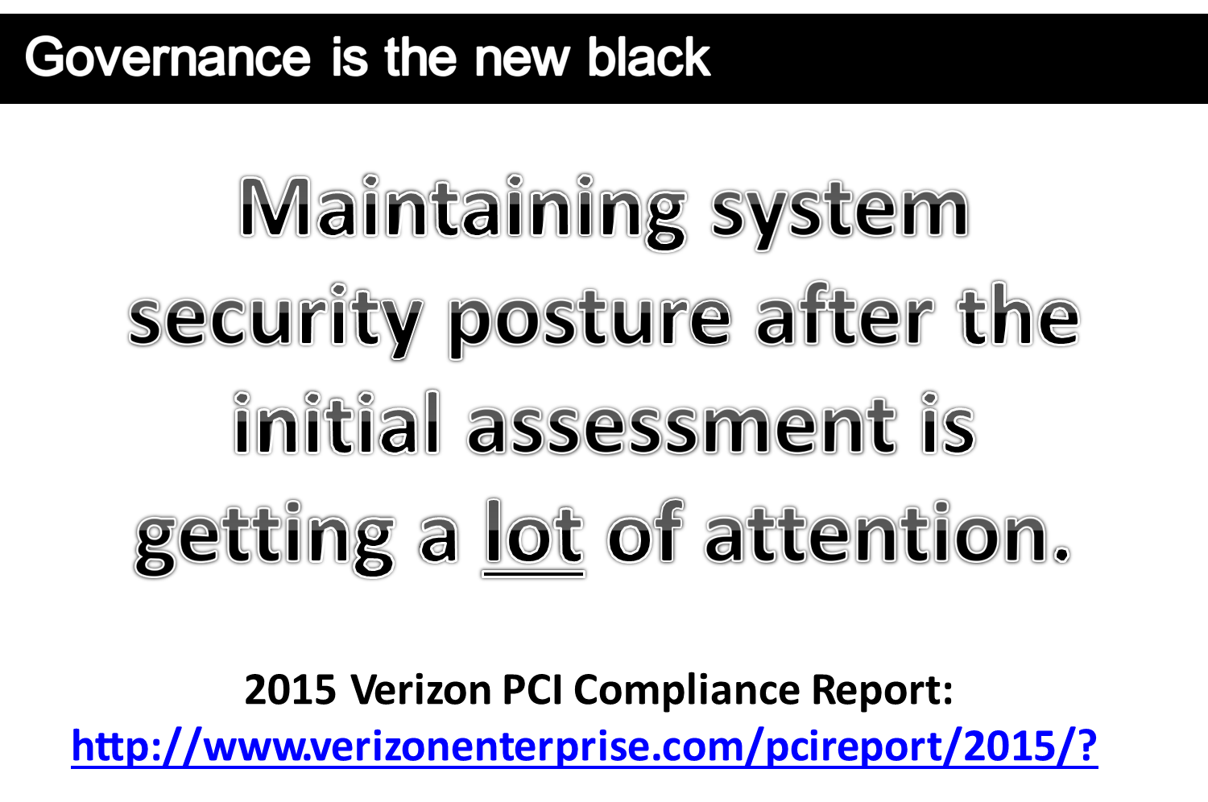

Slide 9
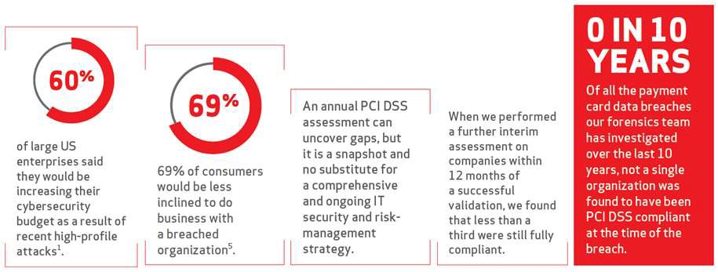
Key snapshots pulled from the report

Slide 10
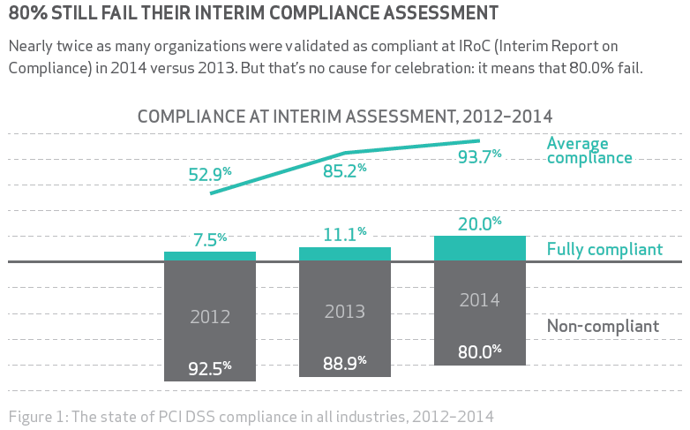
Proof in the Performance.

Slide 11
Let’s Get Started.

Slide 12
Session Contents
This chapter presents the following:
System architecture • Computer hardware architecture • Operating system architecture • System security architecture • Trusted computing base and security mechanisms • Information security software models • Assurance evaluation criteria and ratings • Certification and accreditation processes
Notes:
The architecture of a computer system is very important and comprises many topics. The system has to ensure that memory is properly segregated and protected , ensure that only authorized subjects access objects, ensure that untrusted processes cannot perform activities that would put other processes at risk, control the flow of information, and define a domain of resources for each subject. It also must ensure that if the computer experiences any type of disruption, it will not result in an insecure state. Many of these issues are dealt with in the system’s security policy , and the security model is built to support the requirements of this policy. Once the security policy, model, and architecture have been developed, the computer operating system, or product, must be built, tested, evaluated, and rated. An evaluation is done by comparing the system to predefined criteria. The rating assigned to the system depends upon how it fulfills the requirements of the criteria. Customers use this rating to understand what they are really buying and how much they can trust this new product. Once the customer buys the product, it must be tested within their own environment to make sure it meets their company’s needs, which takes place through certification and accreditation processes.
Harris, Shon (2012-11-08). CISSP All-in-One Exam Guide, 6th Edition (Kindle Locations 8633-8641). McGraw-Hill Education. Kindle Edition.
Security terminology and principles • Protection control types • Security frameworks, models, standards, and best practices • Security enterprise architecture • Risk management • Security documentation • Information classification and protection • Security awareness training • Security governance
Harris, Shon (2012-11-08). CISSP All-in-One Exam Guide, 6th Edition (Kindle Locations 1007-1011). McGraw-Hill Education. Kindle Edition.

Slide 13
Chris's View

Slide 14
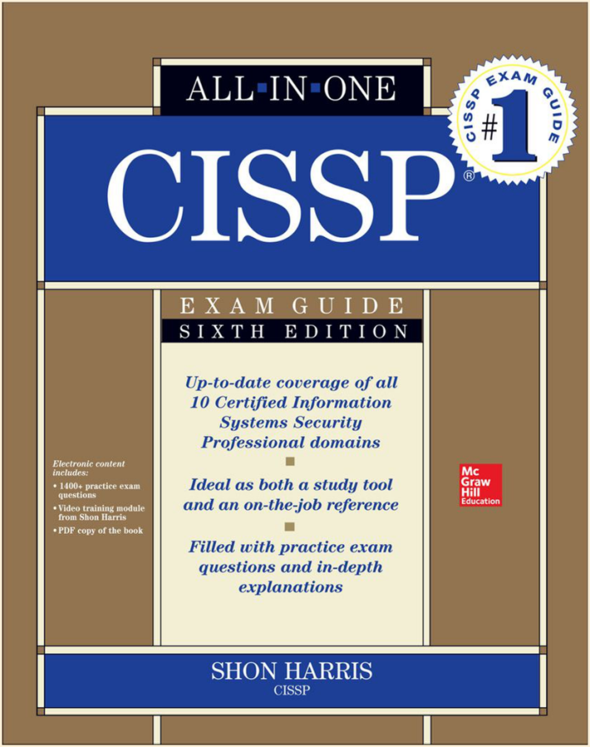
Today's Materials
Harris, Shon (2012-11-08).
CISSP All-in-One Exam Guide, 6th Edition.
McGraw-Hill Education.

Slide 15
Chapter 12: Operations Security
Brian E. Brzezicki

Slide 16
Operations security
Most of this chapter is review
Brian E. Brzezicki

Slide 17
Overview
Operations Security
Day to day tasks, once network is deployed/operational
Ensuring people have necessary access controls
Ensures monitoring and auditing
Ensures systems, networks and environments are properly secured and updated
Lots of overlap with all the other topics. This is the day to day implementation of other concepts.
Brian E. Brzezicki

Slide 18
Goals
To implement due care.
To ensure that people, applications, equipment and overall environment is properly secured.
This includes physical concerns such as ensuring humidity controls, secure media reuse and destruction, and utilities are provided in a reliable and secure fashion.
This also includes verification methods to ensure that standard and compliance requirements are met.
Brian E. Brzezicki

Slide 19
Administrative management
Operationally important administrative concepts
Separation of duty
Job rotation
Mandatory vacations
Least privilege
Brian E. Brzezicki

Slide 20
Security Administrator
Day to day responsibly for implementation and administrating the security controls.
The security admin should not report to the network administrator.
Responsibilities
Implement and MAINTAIN security devices and software
Security assessments
Set initial passwords for users.
Implement and maintain access controls
Configure security labels on MAC systems
does not actually classify data or authorize access
Review audit logs
Brian E. Brzezicki

Slide 21
Accountability
Auditing needs to take place in a routine manner
Access attempts MUST have the user id included.
Someone MUST actually read over the logs
There are automated tools to analyze logs
Ask yourself 3 questions when reading logs
Are users accessing stuff that they don’t need to access in order to do their job (secure perms better)
Are repetitive mistakes begin made (require re-training)
Do too many users have rights to restrictive info? (need to analyze/re-evaluate data access rights)
Brian E. Brzezicki

Slide 22
Clipping Level
The threshold of violations attempts that should be considered normal and not logged.
Example:
A system may be configured to only log login failures after a user has failed 3 times.
Why use clipping levels
avoid to many false positives, avoid overwhelming the analyst
Clipping level thresholds should NOT be known to end-users
Brian E. Brzezicki

Slide 23
IPL
Initial Program Load – a mainframe term for loading the OS into the computers main memory.
Same concern exists with booting a workstation or server.
Concerns of securely booting on next slide
Brian E. Brzezicki

Slide 24
Concerns for security booting
Boot up sequence should not be available for normal users to re-configure?
System logging should not be able to be bypassed
Log output should not be able to be redirected
Users should not be able to initiate a shutdown
Brian E. Brzezicki

Slide 25
Trusted Recovery
When an OS or app crashes, it should not put the system in an insecure state! An OS’es response to a failure can be one of the following*
System reboot – a controlled shutdown and restart in response to a TCB failure. This restores the system to a stable secure state
Emergency system restart – when the system detects an activity that cannot be recovered without restarting.
a system reboot is a clean restart. An emergency restart, is a shutdown with a restart.
Cold start – when an unexpected kernel or medial failure happens and the regular recovery procedure cannot recover the system to a consistent state, human intervention may be required to actually bring the system back online. Until then the system is shutdown. The steps to bring the system back online are on the next slide
Brian E. Brzezicki

Slide 26
Input/Output
I/O security needs to be concerned with ensuring input and output to a system happens securely.
That users cannot put in false info
Input is validated
Transactions should be recorded and time stamped
Non-repudiation issues
Encryption of data
Brian E. Brzezicki

Slide 27
System Hardening
What is system hardening
Remove disable accounts
Remove disable services/software
Remove compilers
Run services as restricted accounts
Configure services for maximum security
Configure OS setting for max security
Install host based firewall and IDS
Install access controls, TCPwrappers, auditing
Keep machine and services patched and up to date.
Brian E. Brzezicki

Slide 28
System Hardening
Restrict physical access
Lock network equipment and access
Secure removable media access
Secure console
use a physically different server (or VM) for each service
Brian E. Brzezicki

Slide 29
Remote Access Security
More mobile/virtual workforces now a days. Need to secure Remote Access
Strong authentication of users
Proper cataloging and auditing of media
Look at labeling on 1053
Encrypting data
Critical systems should not be adminstrated remotely.
Brian E. Brzezicki

Slide 30
Configuration Management
Important in actually running a network or business, especially when subject to regulation (ex. SOX)
There should be a change control policy and process (next slide)
Important during operational use
Important during the whole lifecycle of a product
service packs etc are types of changes!
Brian E. Brzezicki

Slide 31
Change control process
Operational changes happen a lot.
Request a change take place
Approve change
Document the change
Test and present the change
Implement the change
Report change to MANAGEMENT*
Brian E. Brzezicki

Slide 32
Media Control
Day to day media use must reflect the company’s security policy
Backup media must be protected from people and the environment.
Auditing of media access must be done
Company may have media librarian
Media reuse issues
Media destruction (next slide)
Brian E. Brzezicki

Slide 33
Media destruction
Sanitization – process of destroying media when its no longer used.
Data remanence is the residual representation of digital data that remains even after attempts have been made to remove or erase the data. This residue may result from data being left intact by a nominal file deletion operation, by reformatting of storage media that does not remove data previously written to the media, or through physical properties of the storage media that allow previously written data to be recovered.
Various techniques have been developed to counter data remanence. These techniques are classified as clearing, purging/sanitizing or destruction. Specific methods include overwriting, degaussing, encryption, and media destruction.
Brian E. Brzezicki
Notes:
Specific methods[edit]
Overwriting[edit]
A common method used to counter data remanence is to overwrite the storage media with new data. This is often called wiping or shredding a file or disk, by analogy to common methods of destroying print media, although the mechanism bears no similarity to these. Because such a method can often be implemented in software alone, and may be able to selectively target only part of the media, it is a popular, low-cost option for some applications. Overwriting is generally an acceptable method of clearing, as long as the media is writable and not damaged.
The simplest overwrite technique writes the same data everywhere—often just a pattern of all zeros. At a minimum, this will prevent the data from being retrieved simply by reading from the media again using standard system functions.
In an attempt to counter more advanced data recovery techniques, specific overwrite patterns and multiple passes have often been prescribed. These may be generic patterns intended to eradicate any trace signatures, for example, the seven-pass pattern: 0xF6, 0x00, 0xFF, random, 0x00, 0xFF, random; sometimes erroneously^{[clarification needed]} attributed to the US standard DOD 5220.22-M.
One challenge with an overwrite is that some areas of the disk may be inaccessible, due to media degradation or other errors. Software overwrite may also be problematic in high-security environments which require stronger controls on data commingling than can be provided by the software in use. The use of advanced storage technologies may also make file-based overwrite ineffective (see the discussion below under Complications).
There are specialized machines and software that are capable of doing overwriting. The software can sometimes be a standalone operating system specifically designed for data destruction. There are also machines specifically designed to wipe hard drives to the department of defense specifications DOD 5220.22-M.^{[citation needed]}
Feasibility of recovering overwritten data[edit]
Peter Gutmann investigated data recovery from nominally overwritten media in the mid-1990s. He suggested magnetic force microscopy may be able to recover such data, and developed specific patterns, for specific drive technologies, designed to counter such.^{[2]} These patterns have come to be known as the Gutmann method.
Daniel Feenberg, an economist at the private National Bureau of Economic Research, claims that the chances of overwritten data being recovered from a modern hard drive amount to "urban legend".^{[3]} He also points to the "18½ minute gap" Rose Mary Woods created on a tape of Richard Nixon discussing the Watergate break-in. Erased information in the gap has not been recovered, and Feenberg claims doing so would be an easy task compared to recovery of a modern high density digital signal.
As of November 2007, the United States Department of Defense considers overwriting acceptable for clearing magnetic media within the same security area/zone, but not as a sanitization method. Only degaussing or physical destruction is acceptable for the latter.^{[4]}
On the other hand, according to the 2006 NIST Special Publication 800-88 (p. 7): "Studies have shown that most of today’s media can be effectively cleared by one overwrite" and "for ATA disk drives manufactured after 2001 (over 15 GB) the terms clearing and purging have converged."^{[5]} An analysis by Wright et al. of recovery techniques, including magnetic force microscopy, also concludes that a single wipe is all that is required for modern drives. They point out that the long time required for multiple wipes "has created a situation where many organisations ignore the issue all together – resulting in data leaks and loss."^{[6]}
Degaussing[edit]
Degaussing is the removal or reduction of a magnetic field of a disk or drive, using a device called a degausser that has been designed for the media being erased. Applied to magnetic media, degaussing may purge an entire media element quickly and effectively.
Degaussing often renders hard disks inoperable, as it erases low-level formatting that is only done at the factory during manufacturing. In some cases, it is possible to return the drive to a functional state by having it serviced at the manufacturer. However, some modern degaussers use such a strong magnetic pulse that the motor that spins the platters may be destroyed in the degaussing process, and servicing may not be cost-effective. Degaussed computer tape such as DLT can generally be reformatted and reused with standard consumer hardware.
In some high-security environments, one may be required to use a degausser that has been approved for the task. For example, in US government and military jurisdictions, one may be required to use a degausser from the NSA's "Evaluated Products List".^{[7]}
Encryption[edit]
Encrypting data before it is stored on the media may mitigate concerns about data remanence. If the decryption key is strong and carefully controlled, it may effectively make any data on the media unrecoverable. Even if the key is stored on the media, it may prove easier or quicker to overwrite just the key, vs the entire disk. This process is called crypto erase in the security industry.^{[8]}
Encryption may be done on a file-by-file basis, or on the whole disk. Cold boot attacks are one of the few possible methods for subverting a full-disk encryption method, as there is no possibility of storing the plain text key in an unencrypted section of the medium. See the section Complications: Data in RAM for further discussion.
Other side-channel attacks (such as keyloggers, acquisition of a written note containing the decryption key, or rubber hose cryptography) may offer a greater chance to success, but do not rely on weaknesses in the cryptographic method employed. As such, their relevance for this article is minor.
Media destruction[edit]
The pieces of a physically destroyed hard disk drive.
Thorough destruction of the underlying storage media is the most certain way to counter data remanence. However, the process is generally time-consuming, cumbersome, and may require extremely thorough methods, as even a small fragment of the media may contain large amounts of data.
Specific destruction techniques include:
Physically breaking the media apart (e.g., by grinding or shredding)
Chemically altering the media into a non-readable, non-reverse-constructible state (e.g., through incineration or exposure to caustic/corrosive chemicals)
Phase transition (e.g., liquefaction or vaporization of a solid disk)
For magnetic media, raising its temperature above the Curie point
For many electric/electronic volatile and non-volatile storage mediums, exposure to electromagnetic fields greatly exceeding safe operational specifications (e.g., high-voltage electric current or high-amplitude microwave radiation)^{[citation needed]}

Slide 34
Storage Availability
RAID | Backup Concepts

Slide 35
Failure Resistant Disk System
FRDS
Protects servers from data loss (e.g. disk failure – Loss of availability)
Capable of rebuilding the lost disk with a replacement
FRDS Plus (FRDS+)
Can hot swap failed disks while the server is still running
Improved standard over FRDS

Slide 36
RAID Storage Techniques
Striping
Striping is a technique which offers the best performance of any RAID configuration. In a striped array, data is interleaved across all the drives in the array.
Mirroring
With mirroring, whatever you write to one drive, gets written simultaneously to another. Thus, you always have an exact duplicate of your data on the other drive.
Parity
Parity is used to reconstruct data on a drive that has failed.
How it works:
Your RAID controller adds a parity byte to all binary information written to the array. These parity bytes add up to equal either an even or an odd number. The controller can determine whether the information has been compromised in any way. If it has, it can replace the data automatically. E.g. 2+_ = 7… Answer: 5
Notes:
From: http://www.raidrecoveryguide.com/techniques.html
Striping
Striping is a technique which offers the best performance of any RAID configuration. In a striped array, data is interleaved across all the drives in the array.
An analogy may be helpful in understanding how striping works.
Imagine you asked a friend to write down all the numbers between 0 and 100. It would probably take him a few minutes to jot them all down. Now imagine that instead of asking just one friend to write down the numbers, you asked ten friends to divide the numbers up equally amongst themselves so that one writes down 0 to 9, another 10 to 19, and so on and so forth until all were assigned a task. It would take a fraction of the time. This is how striping works. By splitting up the data and distributing it across multiple drives, you increase performance.
Performance in a striped array is dependant on the stripe width (the number of drives in the array) and the stripe size (the size of the chunks of data being written across the array). Striping can occur at two different levels: byte level and block level. Byte level striping involves breaking up the data into bytes and storing them sequentially across the hard drives. Block level striping involves breaking up the data into a given block size. These blocks are then distributed in the same way across the array as in byte level striping.
So, what stripe size should you use to wring the most performance out of your RAID? Well, that depends on what type of application you're using it for.
Larger stripes mean fewer accesses to the disk. For this reason, larger stripes are useful for I/O-intensive (Input/Output) applications such as database servers. Smaller stripes on the other hand, mean that data can be accessed more quickly because data chunks are smaller. Consequently, smaller stripes are better suited for throughput-intensive applications such as video production and editing.
Mirroring
Although a striped array may offer the best performance of any RAID configuration, it provides no redundancy. If one drive in the array fails, all of your data will be lost and you may need to consider RAID data recovery options.
That's where mirroring comes in. With mirroring, whatever you write to one drive, gets written simultaneously to another. Thus, you always have an exact duplicate of your data on the second drive. This is one of the two data redundancy techniques used in RAID to protect you from data loss. The advantage of this technique is that when one hard drive in the array fails, the system can still continue to operate since there are two copies of the data. Downtime is minimal and rebuilding the data from the good copy is relatively easy.
Mirroring also provides a small performance boost over a single non-arrayed drive. Since the mirrored pairs contain the same data, the RAID controller can read data from one drive while simultaneously requesting data from the other. Of course, write speeds will be slower than with other techniques because data must be written twice, once on each drive.
Parity
Parity is an error correction technique commonly used in certain RAID levels. It is used to reconstruct data on a drive that has failed in an array.
Here's how it works: your RAID controller adds a parity byte to all binary information being written to the array. Basically, this is just an extra byte of data tacked onto the actual data. These parity bytes are added up by the controller to equal either an even or an odd number. By analyzing this value, the controller can determine whether the information has been compromised in any way. If it has, it can replace the data automatically with data from the other drive.
You may be wondering how the parity data is created in the first place. Well, typically it's done using a logical operation called eXclusive OR (XOR). Basically, the controller analyzes the series of 0's and 1's which make up the data, and returns either a TRUE (for even numbers) or FALSE (for odd ones). By using this data, it can "fill in the blanks". It's like being back in your high school algebra class. You know that 3 + 6 = 9. If you see the equation 3 + _ = 9, you know the blank is supposed to be a 6. The XOR logic is used in this way to rebuild corrupted data on the array, thus maintaining integrity.

Slide 37
Comparing RAID Levels 0-5

Slide 38

Data Backup: RAID-0 “STRIPED”
RAID-0 is a striped disk array; each disk is logically partitioned in such a way that a "stripe" runs across all the disks in the array to create a single logical partition. For example, if a file is saved to a RAID-0 array, and the application that is saving the file saves it to drive D, the RAID-0 array distributes the file across logical drive D. In this example, it spans all six disks.
From a performance perspective, RAID-0 is the most efficient because it can write to all six disks at once. The drawback to RAID-0 is its lack of reliability.

Slide 39
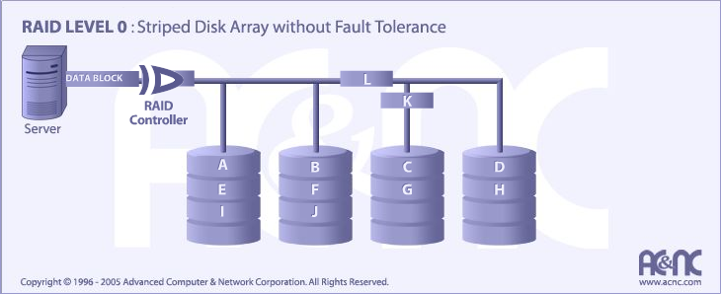
Data Backup: RAID-0 (Alternate View)

Slide 40
Data Backup: RAID-1 “MIRRORED”
RAID-1 is a mirrored disk array in which two disks are mirrored.
RAID-1 is the most reliable of the three RAID disk arrays because all data is mirrored after it is written. You can use only half of the storage space on the disks. Although this may seem inefficient, RAID 1 is the preferred choice for data that requires the highest possible reliability.

Slide 41
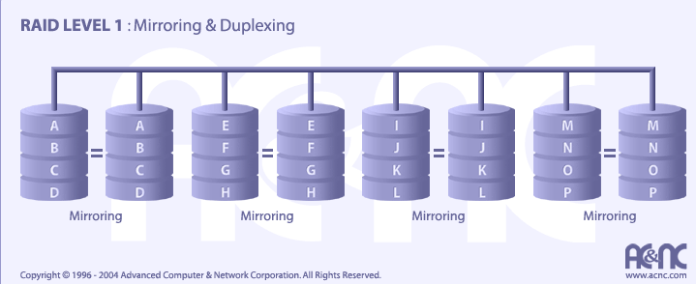
Data Backup: RAID-1 (Alternate View)

Slide 42

Data Backup: RAID-5
RAID-5 is a striped disk array, similar to RAID-0 in that data is distributed across the array; however, RAID-5 also includes parity (yellow part of disk below). This means that there is a mechanism that maintains the integrity of the data stored in the array, so that if one disk in the array fails, the data can be reconstructed from the remaining disks.
RAID-5 is a reliable storage solution.
Parity split among the drives in RAID 5

Slide 43
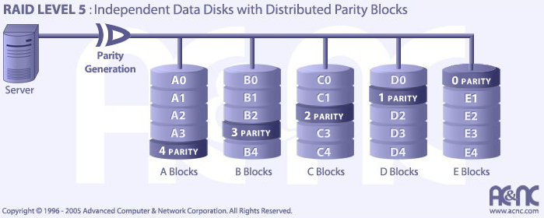
Data Backup: RAID-5 (Alternate View)

Slide 44
Data Backup: RAID-10
Combines:
RAID 10 is implemented as a RAID 0 (striped array) whose segments are RAID 1 (mirrored) arrays
A
D
G
B
E
H
C
F
I

Slide 45
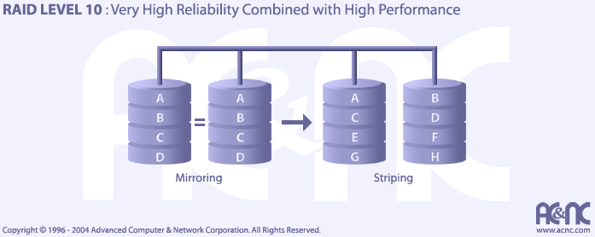
Data Backup: RAID-10 (Alternate View)

Slide 46
Data Backup: RAID-0+1
Combines:
RAID 0+1 is implemented as a mirrored array whose segments are RAID 0 arrays

Slide 47
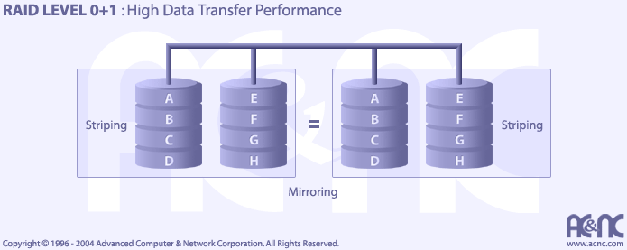
Data Backup: RAID-0+1 (Alternate View)

Slide 48
Data Backup: RAID-15
Combines:
Level 1 (mirroring)
Level 5 (interleave (or distributed parity))

Slide 49
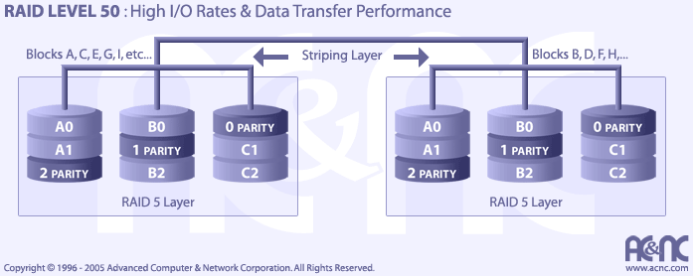
Data Backup: RAID50
RAID Level 50 is a RAID 0 (striped) array which is striped across a RAID 5 array. Performance is improved compared to RAID 5 because of the striped array and fault tolerance is improved because of the RAID 5.

Slide 50
Backup Concepts
Full
Complete backup of every file, every time
Baseline tape sets
Requires the most time and tape space
Incremental
Only files that have been added or changed since last incremental
Used when time/network is at premium
Accomplished by resetting the archive bit on the files after they have been backed up
Archive bit says “I’ve been backed up already – thanks!”
Differential
Only copies files that have changes since a full backup was last performed.
Additive in that it takes longer every day you get away from last full backup
Each file’s archive bit is NOT reset until the next full backup.

Slide 51
Backups… Visual Aide
Thursday…
Changes…
Differences: Think about the recovery….
Wednesday
Changes…
Tuesday
Changes…
Monday
Baseline
Baseline
Baseline
Full
Incremental
Differential

Slide 52
Backup Issues
Challenges to consider include:
Slow data transfer of backup
Globalization
Server disk space increases over time
Lost data between backup and when server goes down... Not recoverable from backups

Slide 53
Network and resource availability
Brian E. Brzezicki

Slide 54
Network and resource availability ()
Availability is often overlooked but is of fundamental importance.
Redundant hardware – ready to hot or cold swap
Fault Tolerant technology
Service Level Agreements (both from providers and what SLA you provide internally to departments)
Solid operational procedures
Documented procedures
Practice of recovering from issues!
Brian E. Brzezicki

Slide 55
MTBF
Mean (average) Time Between Failure – all equipment (especially moving equipment) will eventually fail. MBTF is the average expected life time of a device
What does this mean to you? How do you use MTBF?
Brian E. Brzezicki

Slide 56
MTTR
Mean Time To Repair – expected time to get a device fixed and back into production.
If MTTR is too high, you might want to have redundant systems or spare parts.
Brian E. Brzezicki

Slide 57
Single Point of Failure
What does this mean?
What are some examples.
What are some technologies to control this
HSRP
Alternate routing vs. diverse routing*
RAID
RAIT
Clusters / Load balancers
Virtualization
Grid computing – example DES challenge / SETI@home
SANs and NAS
Brian E. Brzezicki

Slide 58
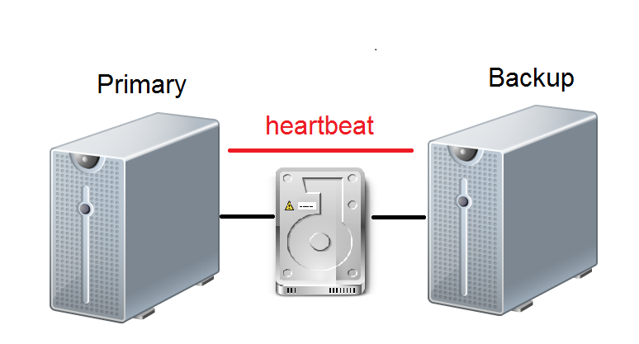
Clustering (Active/Passive)
Brian E. Brzezicki

Slide 59
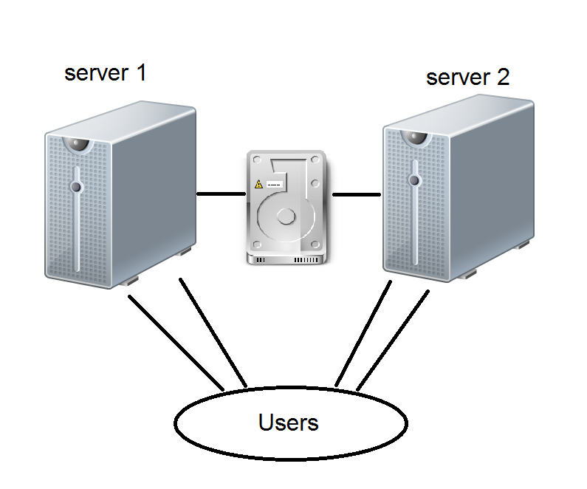
Clustering (Active/Active)
Brian E. Brzezicki

Slide 60
Virtualization
Virtualization is KEY to network security, availability and maintenance/ease of operation.
What does it allow you to accomplish
How does it make your life as an admin easier
How does it increase availability
How does it allow you to make servers more modular?
How does it increase security and integrity?
Brian E. Brzezicki

Slide 61
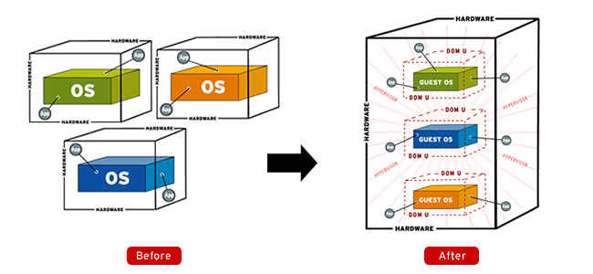
Virtualization
Brian E. Brzezicki

Slide 62
Backups
Backups and Data Archiving
RAID does not make backups unnecessary!
Backups should be done regularly
All needed information is backed up
Backups must be verified
Restores must be tested
Store offsite / and onsite
Archive backups for permanent storage
Brian E. Brzezicki

Slide 63
Email Security
Email is relied upon every day
SMTP (TCP/25) to send mail
No true security
No user authentication (spoofing)
No encryption
Problems with relaying*
SPAM/Virus/Trojans/Phishing
Sending and Receiving
POP TCP/110
Downloads all mail
No encryption
IMAP TCP/143
Leaves mail on server, more incremental
No encryption
Use SSL or VPNs when using POP/IMAP
Brian E. Brzezicki

Slide 64
Additional Key Terms

Slide 65
From Authorities to Audits
Examples
Technical, physical, and administrative requirements that must be in place to ensure compliance with the authorities
Statements of how a company will implement and enforce requirements
Implementation of the technical, physical, and administrative requirements found in the policy statements
Verification of appropriately implemented controls to comply with requirements
PCI
HIPAA
NERC
Authorities
Requirements
Policies
Controls
Audits
PCI-DSS Example
Authority: PCI-DSS is the authority document created by the PCI-SSC.
Requirement: (10.6) Review logs for all system components at least daily.
Policy: Monitoring Policy – States logs will be reviewed at least daily.
Control: Tool XYZ provides real-time monitoring for all system components.
Audit: Auditor verifies Tool XYZ is appropriately monitoring and alerting to actionable events. Audit results and evidence are stored as part of the audit.

Slide 66
Effectively Managed IT Controls
Technology can affect every part of the business.
At its best, technology is a competitive advantage.
At its worst, technology is your competitor’s advantage.
Product
Market Relationships
IT Controls:
Detective, protective and reactive measures in place to protect the confidentiality, integrity, and availability of business information and ensure appropriate management of the IT function to meet business objectives.
Inbound Logistics
Operations
Outbound Logistics
Marketing
and Sales
Service
Firm Infrastructure
HR Management
Margin
Procurement
Technology Development
Notes:
Compliance Control: A process, effected by management and other personnel, designed to provide reasonable assurance that transactions are executed in accordance with 1) laws governing the use of budget authority and other laws and regulations that could have a direct and material effect on the financial statements or required supplementary stewardship information and 2) any other laws, regulations, and government wide policies identified in OMB audit guidance. [GAO/PCIE Financial Audit Manual]
Source: http://www.unifiedcompliance.com/it_compliance/language_compliance/definitions/c.html

Slide 67
Chris Davis
UTD Email: cmd140430@utdallas.edu
Google Voice: 214-771-8122
Course Materials
https://elearning.utdallas.edu

Slide 68
Additional Materials

